Slide 1
Emotion recognition
Tianqi Liu
Hanzhang Zeng

Slide 2
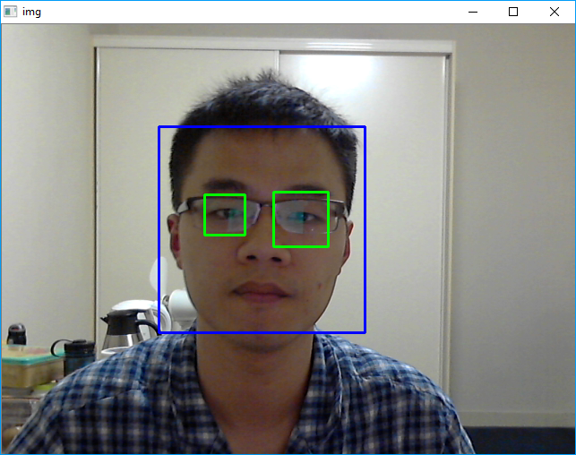
Image processing (extract faces)
Use frontal face Cascade Classifier (provided by Intel) to crop image

Slide 3
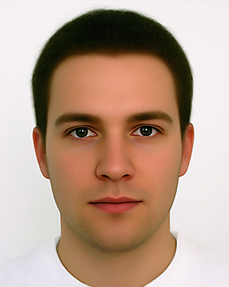


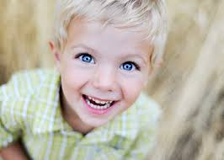
Emotion categories
Neutral
Happy
Angry
Sad
Create individual training set for each category

Slide 4


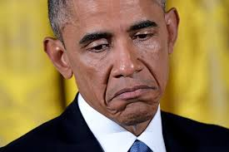
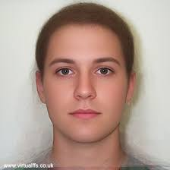
HAARCASCAde TRAINING
Program
1. Save a large set of facial expression for each categories. (Cohn-Kanade)
2. Feed the input facial expression into comparison algorithm.
3. Train the FisherFace recogniser by feeding face set

Slide 5

Prediction
Crop
Fisherface
Algorithm
Prediction
Result
Neutral
Happy
Angry
Sad
SAD

